Slide 1
QUALITY CONTROLS

Slide 2
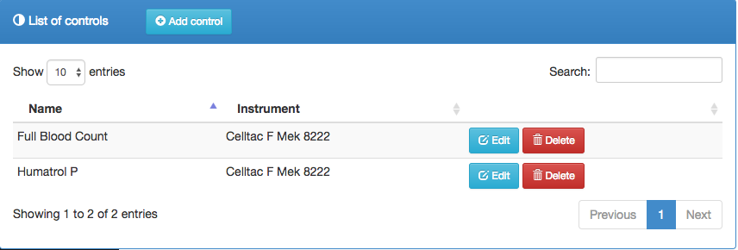
Quality Controls
Shows a list of controls

Slide 3

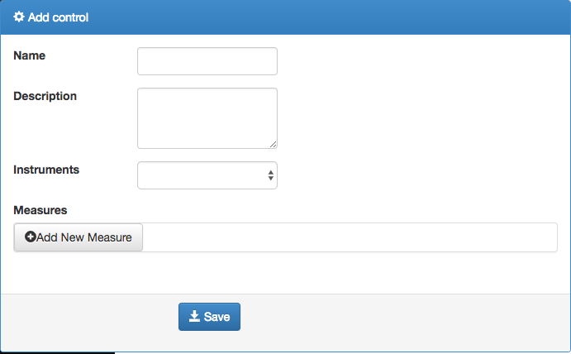
Continuation...
To add a new control click on the button, fill in the fields and save.

Slide 4
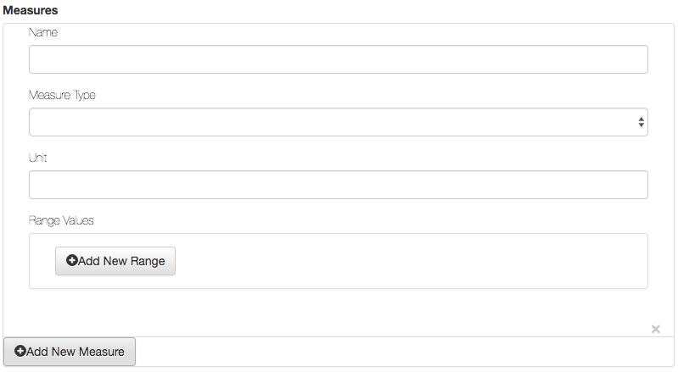
Continuation…
Several measures can be added to a control.

Slide 5


Continuation…
The field allows one to search for a particular control
used to change or modify the details of a control
To delete a control click on the button

Slide 6
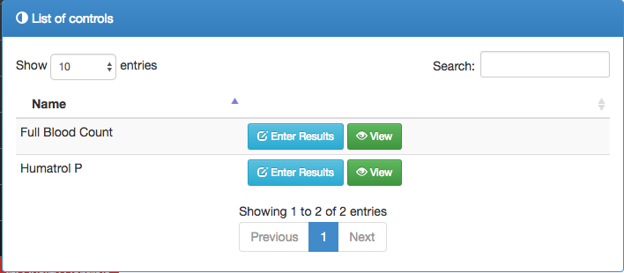
Control Results
Shows the results of a particular control

Slide 7
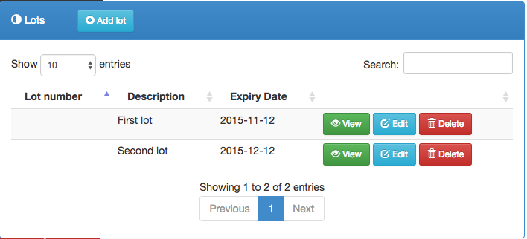
Lots
Shows a group of controls

Slide 8
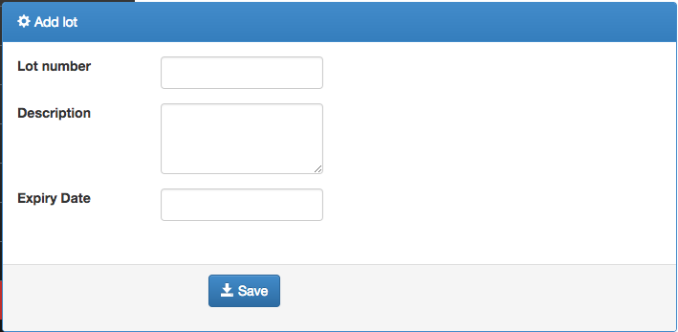
Continuation…
To add a new lot click on the button, fill in the fields then click on save.

Slide 9




Continuation….
The field allows one to search for a certain lot
To view a lots details click on the button
The button enables one to edit a particular lot details
And the button, deletes a lot

